Slide 1
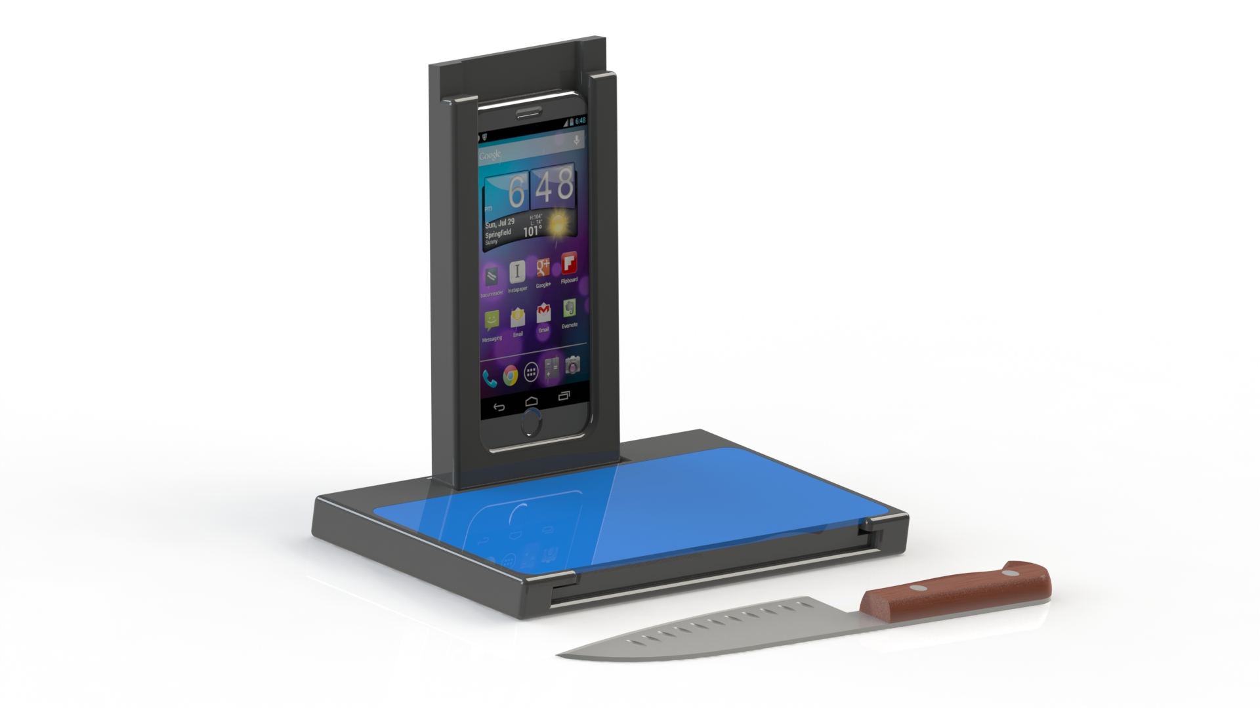
ScreenSavor
Creativity, Professor Rom Schrift
Leila Feldman
Salima Ghadimi
Gregory Howard
Mattias Olsson
Marina Palm
Benjamin Rosenbaum
Nathaniel Sena
Tuesday, December 1st, 2015

Slide 2
Agenda
Context
Concept
Ideation Process
Product Extensions
Advertisements
Notes:
Context → Overview of millennials and how they cook → First three things that come up when you google millennials in the kitchen & stats → The new digital kitchen → When we are thinking about digital kitchen and the needs of millennials we identified three main needs/problems → Hate cleaning up, time efficiency/immediacy, integratable with their technologcailly savvy lifestyle (Data to back up?)
Product → When thinkinking about these challenges, this is what we came up with SCREENSAVOR → Walk through the product features, components, and attributes
Ideation Process → Full overview of thinking (brainstorming, given concepts, lecture from Bill…) → Competitor analysis & Material overview → Configuration → Template →

Slide 3
The Digital Kitchen

Slide 4
Secondary Research – Millennials in the Kitchen
59% of 25- to 34-year-olds bring either smartphones or tablets into the kitchen
68% of millennial moms said that they watch videos while cooking

Slide 5
Technology in the Kitchen
Ideas & Inspiration
Videos & Tutorials
Recipes
Blogs

Slide 6
Identified Problems
Clean-up
Millennials hate cleaning up – We want it to be easy and simple
Immediacy
Quick access to information – Nothing is more than a google search away
Lifestyle & Technology
With smart devices, gadgets become central to the millennial lifestyle
Food inspiration comes from food blogs, online recipe books, or YouTube
Online sources expedite the process of finding a recipe and starting to cook
Notes:
Hate cleaning up, time efficiency/immediacy, integratable with their technologcailly savvy lifestyle

Slide 7
Solution

Slide 8
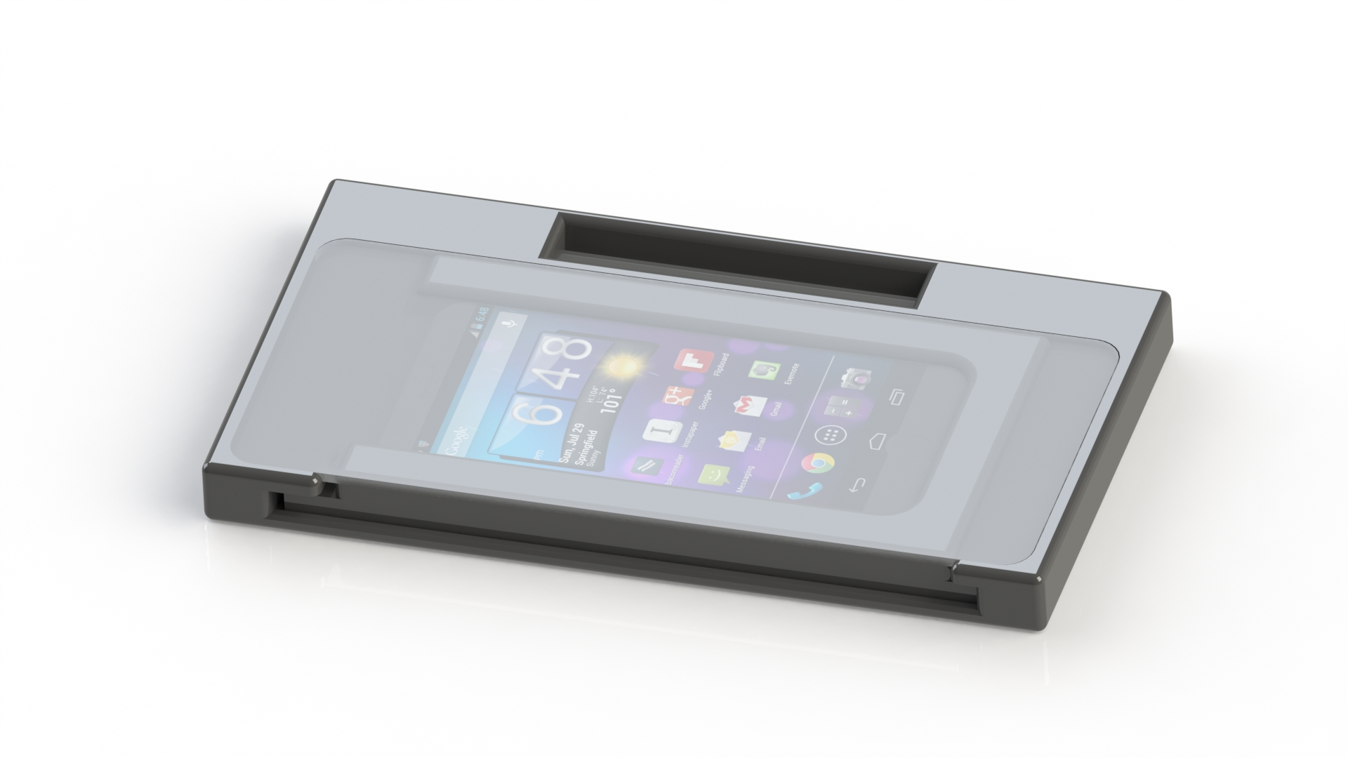
Solution

Slide 9
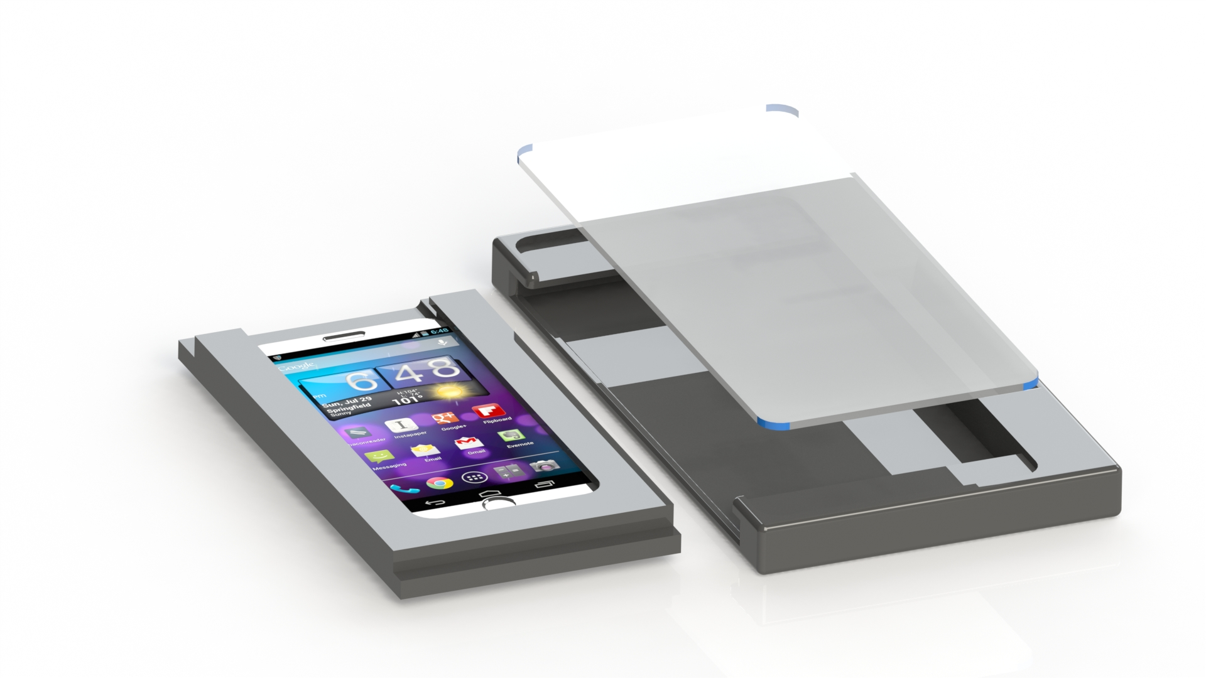
Solution

Slide 10
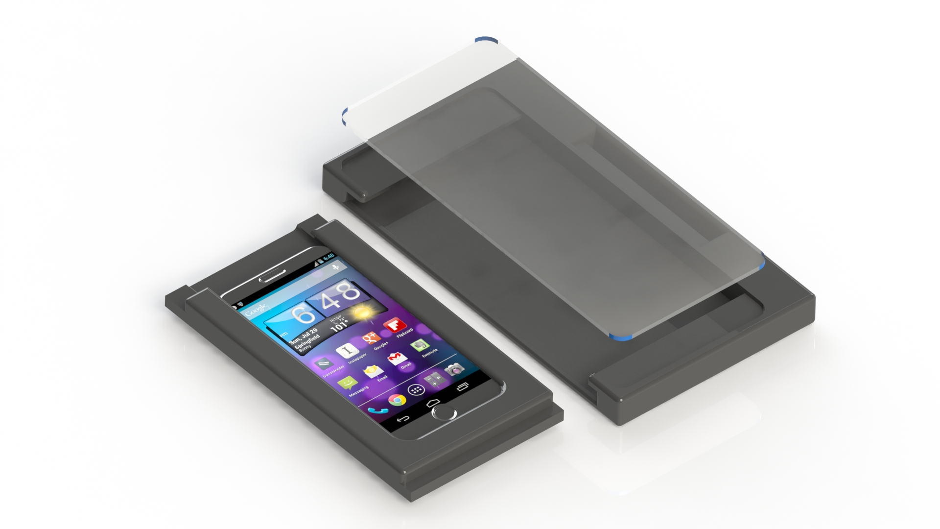
Solution

Slide 11
Benefits
Spill-Safe
Multi-Purpose Design
Dishwasher-Safe
Remove tablet and throw in the dishwasher for a quick and easy clean up
Air tight design guards tablet/smartphone from damage
Use the cutting board to prepare food
Once food is prepared, case can be used as a plate to hold food

Slide 12
Ideation Process
Process Step
Comments
Scope Definition
Topics of interest – Future interests of millennials, how do millennials eat dinner today, effective packaging, open-stock cutting board business
Top-down approach → Integration of several topics
Empathize
Primary research – Exploratory interviews & descriptive surveys
Secondary research – Confirm our primary finding with secondary verification
We wanted to understand our target group
Define
When analyzing the data - Three problems you saw earlier
Competitor analysis – Understanding of what was already out there
Our POV was to solve those three problems with one integrated product
Ideate & Prototype
Brainstorming – Nothing was discriminated against – As crazy ideas as possible
Democratic voting process on concept
List configuration and apply templates
ScreenSavor
Testing
What we are doing with you
Want to explore testing on a larger scale towards millennials in the kitchen
“Design thinking is a mindset, it is about having an intentional process in order
to get new relevant solutions that create positive impact.”

Slide 13
Scope Definition
Topics of Interest
Levels of Innovation
Democratic voting process
Research
Open group discussion about topics of interest
Discussed integration of multiple topics
With the time line of the project – Level 1 seemed feasible
Depending on basic concept, we reasoned that we could expand it into Level 2
After open group discussion, we voted on the concepts we were to focus on
With primary research we tried to single out existing problems
Narrowing problems down to three, we wanted to discover a way to satisfy group by solving those problems

Slide 14
Primary Research
“I like to watch Paula Dean on my tablet and follow along with her. It makes cooking more fun”
Isabel, Penn Senior
NO
28%
43%
YES
72%
76%
“I always use my phone or iPad to look up vegan recipes while I cook.”
Sarah, Penn Sophomore

Slide 15
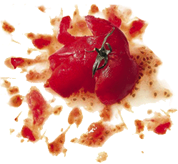
Primary Research
“I actually spilled tomato sauce all over my phone last week”
Celine, Penn Senior
OTHER
Why Wouldn’t You Use a Tablet in the Kitchen?
HARD TO POSITION
RISK OF DAMAGE
CLEAN UP

Slide 16
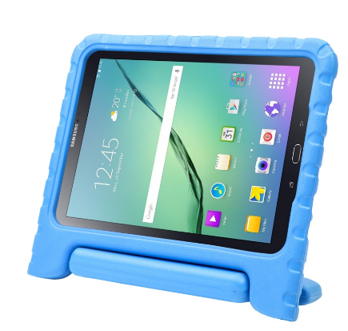
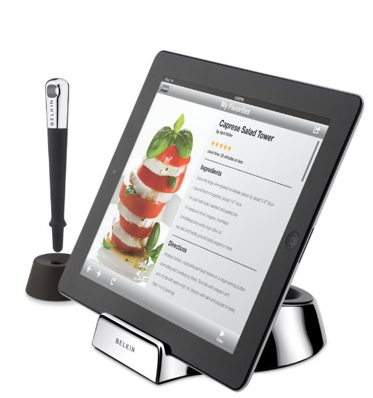
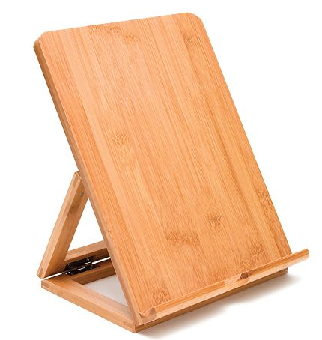
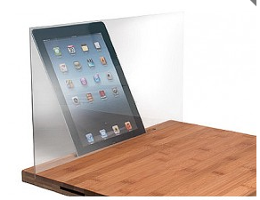
Current Offerings
Existing Alternatives
KidoLight Armor Box
Belkin Kitchen Stand
Lipper Bamboo Folding
CTA Digital Bamboo Stand
Visually unappealing – Lifestyle stands for aesthetically pleasing
Differentiation – Different product needed for different tablets
Bundling – We feel like product could be extended further
Versatility – Complicated use of pen and screen still exposed
Issue – The main issue of the screen being exposed is not resolved
Bundling – We feel like product could be extended further
Issue – The main issue of the screen being exposed is not resolved
Bundling – We feel like product could be extended further
Issue – Although screen is covered, you cannot navigate recipes
Bundling – We feel like product could be extended further
Unsatisfied Need For Versatile Navigation

Slide 17
Best Existing Solution
DISADVANTAGES
Produces a lot of waste
Inconvenience of repeat purchase
Requires purchase of multiple products
Only exists for iPad and iPad 2
Chef Sleeve
Notes:
Clean up
Integration of tech
Immediacy of info
Primary research: Importance of Placement

Slide 18
Templates Applied
Attribute Dependency
Replacement
Subtraction
Multiplication
Division
Task Unification

Slide 19
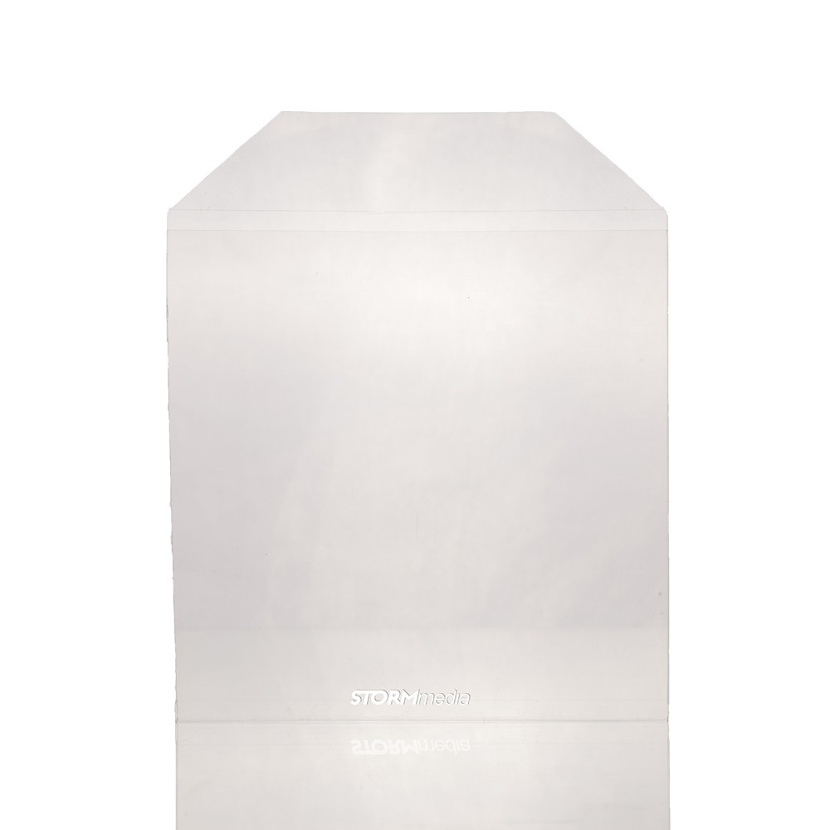
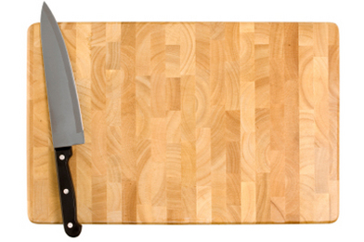
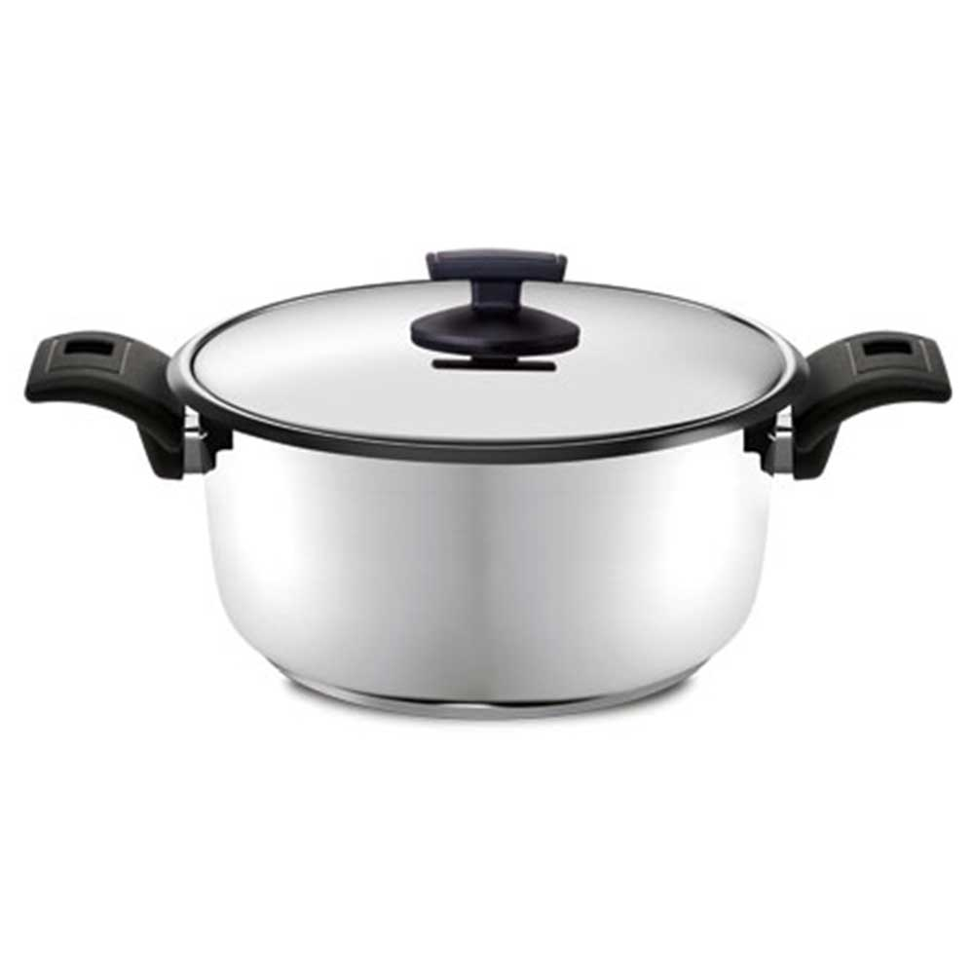
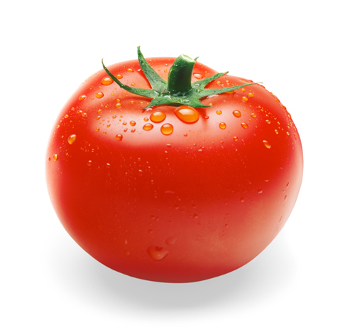
Product Configuration
Tablet/ smartphone
Plastic Sleeve
Tablet
Case
Cutting
board
Humans
Cookware, cutlery, etc.
Ingredients

Slide 20
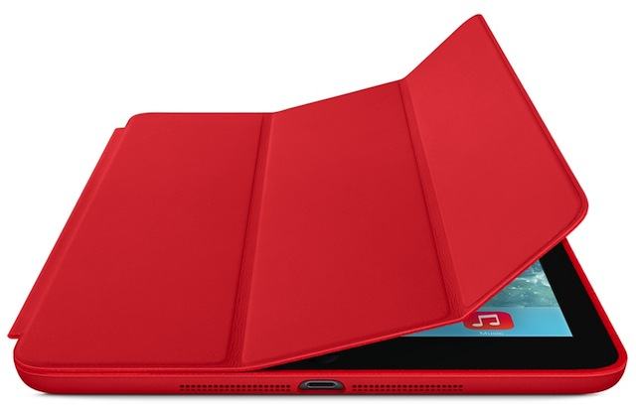
Product Configuration
Tablet/ smartphone
Tablet
Case
Cutting
board
Humans
Cookware, cutlery, etc.
Ingredients

Slide 21
Marketing & Distribution
Brands Offering Cutting Boards
Trendy Brands
Potential Endorsements
Distribution Channels
Potential Endorsements
Potential Endorsements

Slide 22
Advertising Templates Applied
Unification
Activation
Metaphor
Extreme Consequences
Absurd Alternative
Inversion Tool

Slide 23
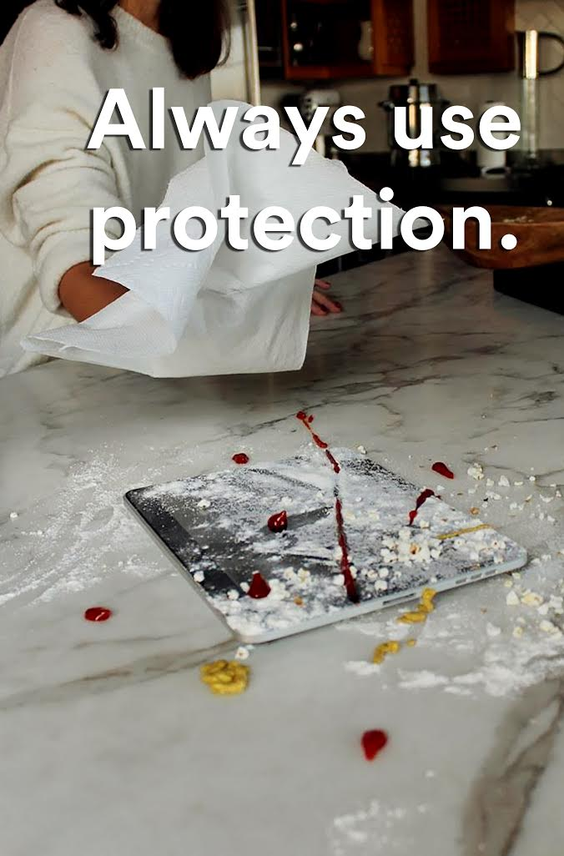

Slide 24
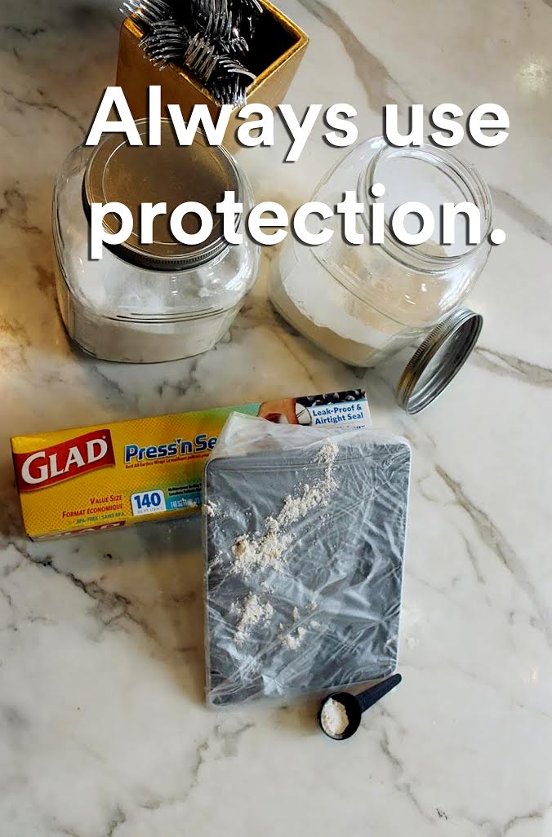

Slide 26
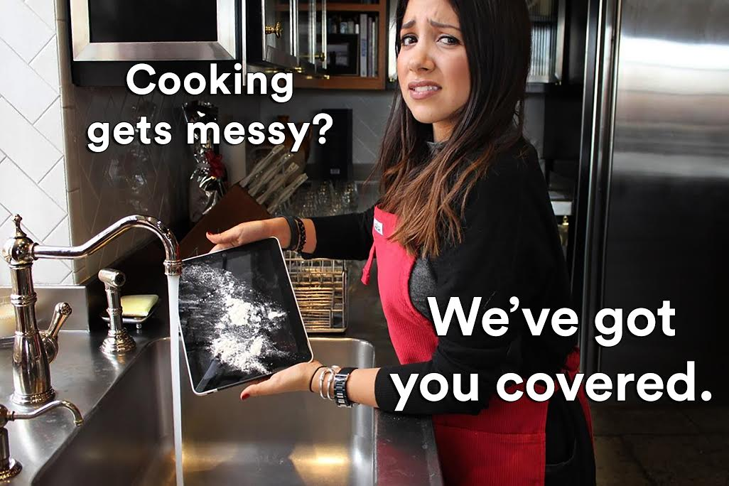

Slide 27
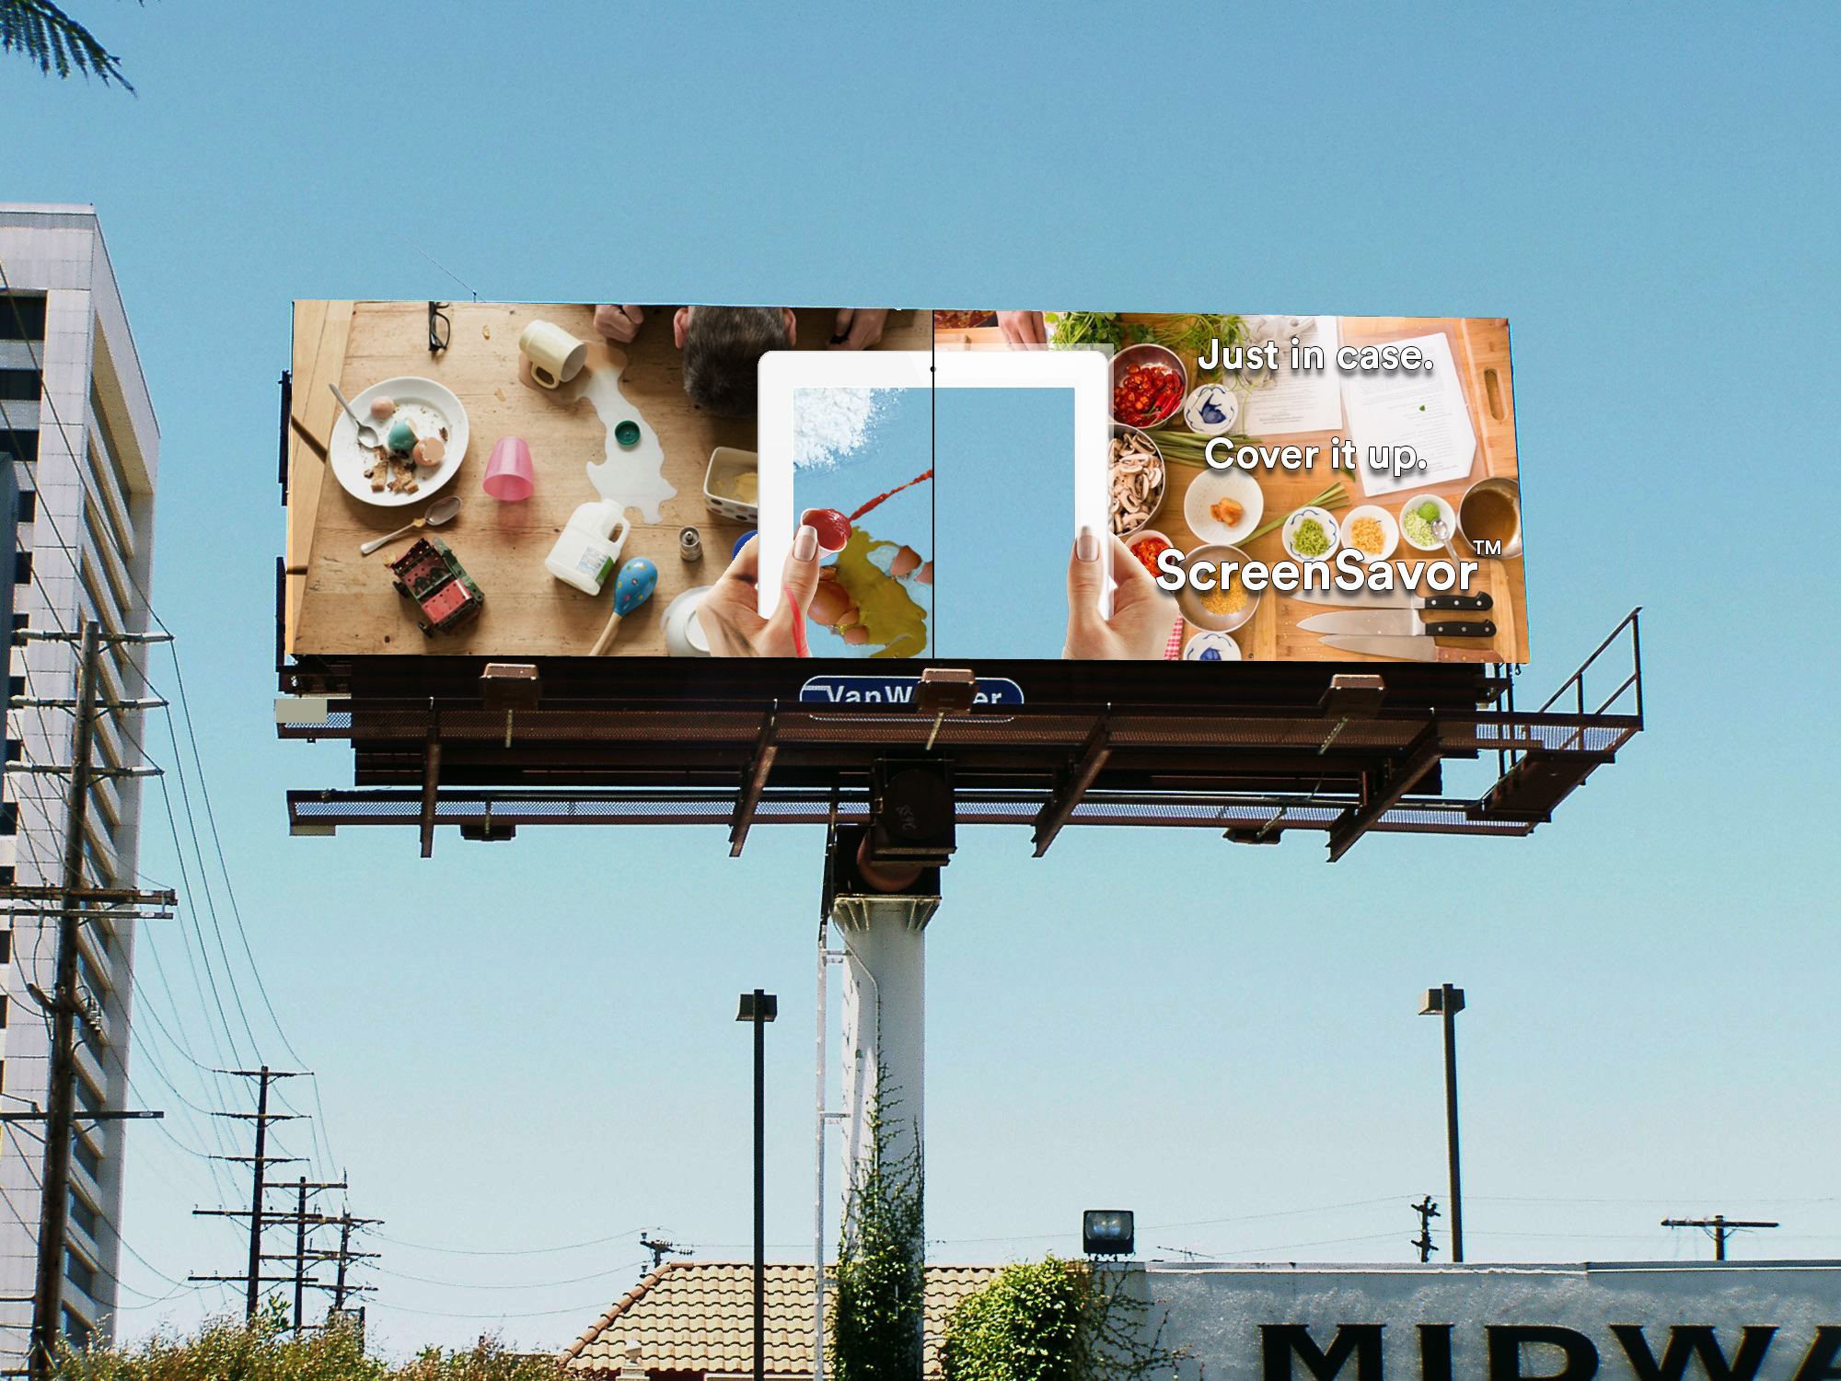

Slide 30
THANK YOU!

